Slide 2
Our Structure of emergency plan and mandate
SAPS - JOC
G911
G911 JOC members
Community Roadblocks
Close businesses
Protect Property and Businesses
Hold and maintain

Slide 3
What worked – Instrumental (Zones)
Our community is divided into 13 different sectors. All similar in size, yet unique in requirements.
Selected – Zone leaders who are tasked with Coordinating security as a whole. (Not just in an emergency). On going……
Instrumental in putting together and implementing a well organized emergency plan as we did in July 2021. Very quickly!
As said earlier, no commando’s or police reserve could be called in.
Teachers, Mechanics, Farmers, Secretaries, Businessman, Housewives. They all came!

Slide 4
What worked – Instrumental (Zones)
G911 JOC members
1
2
3
4
5
6
7
8
9
10
11
12
13
In a very short space of time (1 Hour) – We had our 1000 strong team armed with anything from a rolling pin to an AR

Slide 5
Tugela Ferry
Stanger
Muden/Weenen
Fuel Station
Roadblock Muden/NMR
Roadblock Stanger/Dundee
Greytown
Roadblock PMB
Fuel Station
Mooi River
Pietermaritzburg

Slide 6
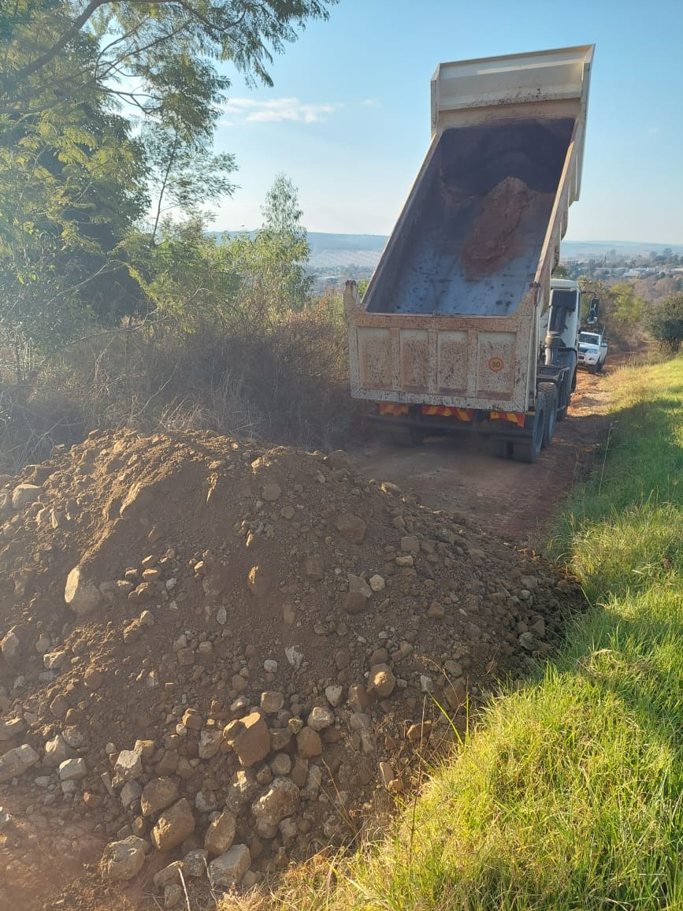

Slide 7
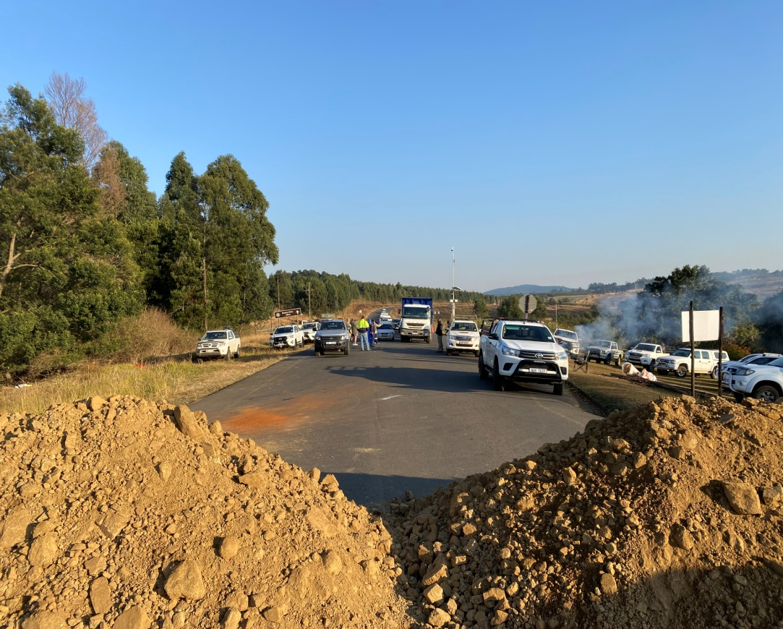

Slide 8
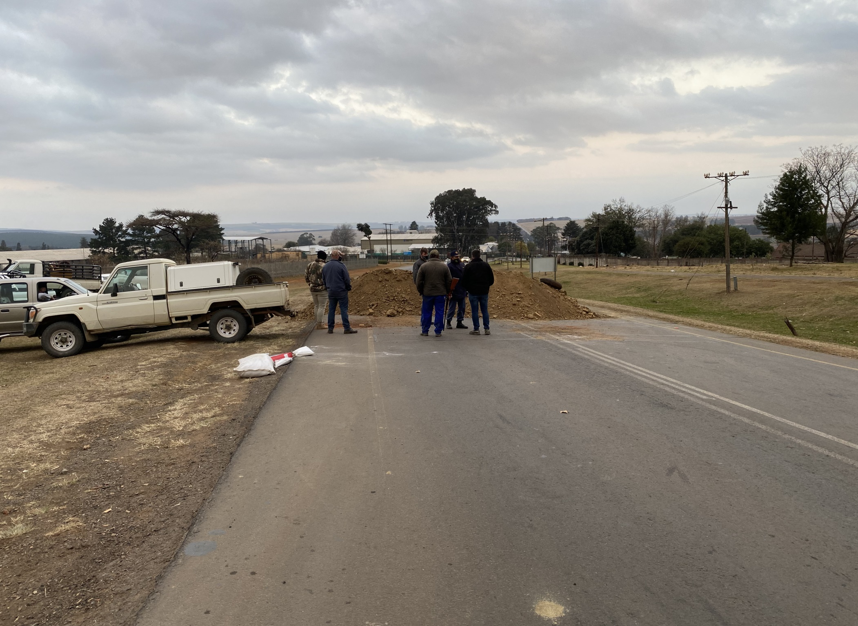

Slide 9
G911 Control
Meals arranged for roadblock Members
Security details to protect critical infrastructure
Whilst the town was now secure and safe. Still plenty work happens behind the scenes
Businesses could go in and assess their situation and deal with what had to be done
Security details for cellular technicians
Fire crews mopped up forest fires
Aircraft made available for air patrols (SAPS on board)
Authorities and Private Security could go in and deal with the opportunists – There were plenty of them
Start looking at the rest of the community – Are they okay
Critical medication checked on and secured
Fuel stocks checked and secured

Slide 10
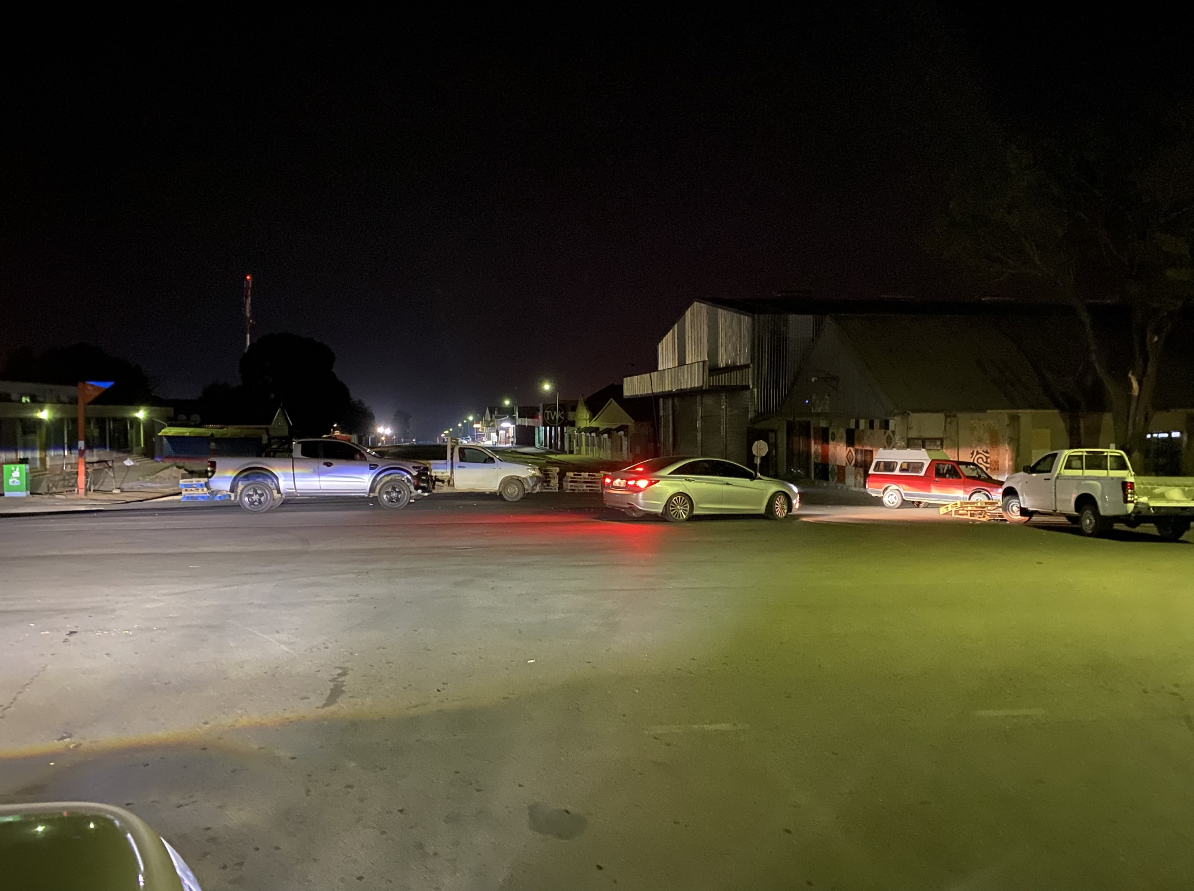

Slide 11
Day 4 -
Mothers running out of food for babies
Traffic starting to break through roadblocks
Everyone is tired
Tensions at roadblocks was on the rise.
Someone was going to get unnecessarily hurt.
Signs were there that we could consider opening

Slide 12
Opening? Happened as quickly as we closed it!
Personal at roadblocks told to disperse and protect selected businesses whilst they open.
Gravel removed
Fuel stations guarded and fuel rationed
Supermarkets guarded and customer numbers controlled
Fuel and food trucks escorted and offloading guarded
Opened and supplies rolling the same day.

Slide 13
Looking back - What worked!
A structure such as G911, someone capable of talking and acting on our behalf.
Already set up systems – Zone leaders, WhatsApp groups a community that has had security drilled into them.
Our radio network was critical during no cellular network
Dedicated persons, who only dealt with the authorities. No matter how frustrating, it had to be done and continue.
Dedicated people who made use of every offering. Aircraft, Dump trucks, TLB’s, checking on vulnerable people, list can go on….
Fuel secured for SAPS, Private Security, Community Security.

Slide 14
What needs work? Largely out of our control
The Intel wasn’t great at all. We didn’t expect it as it happened. We could have done more and earlier!
There was information received that the looters are regrouping and heading for all agricultural infrastructure. We prepared very well for this.
Maybe question how we handle the intel. It’s going to come through anyway….
Whoever runs your security – Must be able to accept criticism. You must know, there are going to be people who are unhappy with you.

Slide 15
Consider the following improvements!
Communications
Behind the scenes!
Message and voice notes are named and dated.
Discipline and Control over forwarding of voice notes and messages
Radio networks and systems have a unique place in communications. Keep them maintained.
Consider satellite based phones and internet
Run your farms and businesses cleaner.
More knowledge on self and property protection. What you can and can’t do.
Security Ass, Farmers Ass and Business Chambers. These need to be on more solid and professional ground than they are.
Plan for the worst – If it doesn’t happen, you lost nothing!

Slide 16
Consider the following in future!
Better and continuous interaction between SAPS, Private Security and Private Business/Farming Sector. No matter how frustrating it is – IT MUST BE DONE!

Slide 17
My final comment
Complain less and do more!

